Slide 1

WARBY PARKER FUNNEL ANALYSIS
Analyze Data with SQL
Ankush Kumar
08-22-2020

Slide 2
TABLE OF CONTENTS
Background & Project Details
Other Insights
Resources
Quiz Funnel
Home Try On Funnel

Slide 3
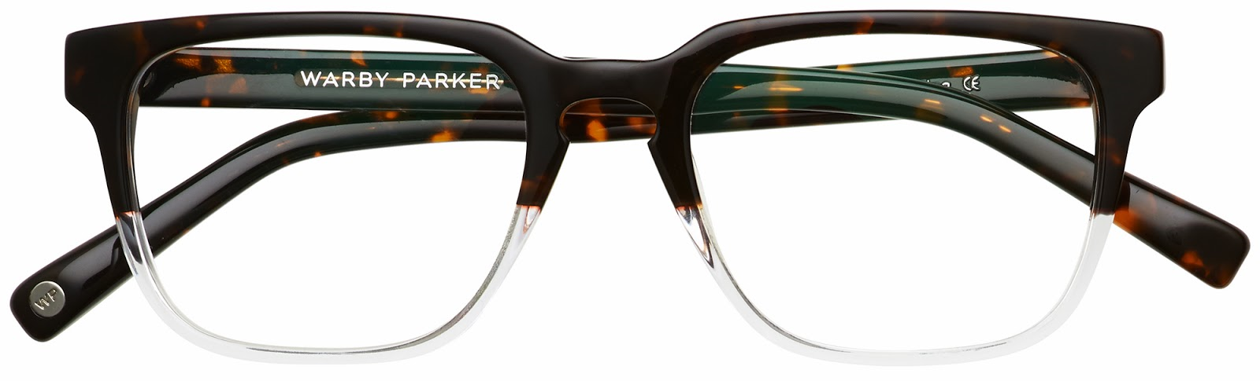
BACKGROUND
Warby Parker (WP) is a transformative lifestyle brand that offers designer eyewear.
Founded in 2010 in the USA
Online manufacturer retailer of prescription glasses
For every pair of glasses sold, a pair is given to someone in need.

Slide 4
PROJECT DETAILS
Analyze marketing funnels
Quiz Funnel: Survey given to customers
Home Try-On Funnel: Customer can try glasses at home before purchase
Project is part of Codecademy course on SQL
Collaboration with WP’s Data Science team
Uses fictional data
Refer to separate .sql file for the queries generated

Slide 5
QUIZ FUNNEL
Warby Parker’s Style Quiz

Slide 6
QUIZ FUNNEL
WP has a Style Quiz (5 questions) to help users find their perfect frame.
500 users started the survey.
Users will “give up” at different points in the survey.
Only 270 out of 500 users answered the final question.
Question 3 & 5 had low completion rates.
Questions | Total Number of Responses | Percent Completed this Question
1. What are you looking for? | 500 | 100%
2. What's your fit? | 475 | 95%
3. Which shapes do you like? | 380 | 80%
4. Which colors do you like? | 361 | 95%
5. When was your last eye exam? | 270 | 75%
Notes:
To help users find their perfect frame, Warby Parker has a Style Quiz that asks 5 questions.
We built the quiz funnel to analyze if certain questions promoted users to stop working on the survey.
The percentage of users completed each question was calculated by dividing the number of people completed each step by the number of people completed the previous step.
For example, the completion rate for question two was 95%. This was calculated by dividing 475 users who completed question two by 500 users who completed question one.
Users can quit the survey any time.
The Question 3 and 5 have low completion rates which are indicated in red.
Those questions refer to the shape of the glasses the users likes and the information about their last eye exam.
Users quit the survey on question two because they might not be sure which shape of glasses they prefer and might want to research them before selecting an option.
Question five might be more of a sensitive question and the user might be reluctant to answer. For example, the user might not have health insurance or does not want people to judge them for not keeping up with their annual checkups.

Slide 7
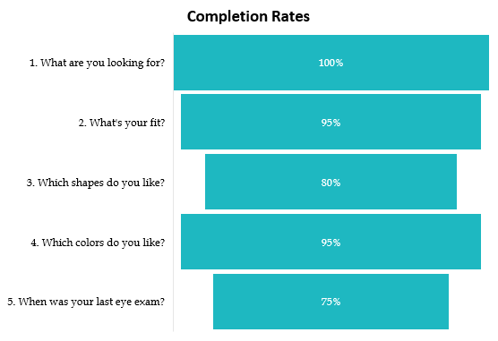
QUIZ FUNNEL
Notes:
The total number of responses graph shows we started the quiz with 500 users and only 270 ended up completing it.
That’s around 54% of the customers who started the survey ended up completing it.
The completion rates graph shows the percent change between each question.
Only 75% of users moved from Question 4 to Question 5.

Slide 8
HOME-TRY-ON FUNNEL
Style Quiz to Actual Sale

Slide 9
HOME TRY-ON FUNNEL
Style Quiz
Home Try On
Purchase
Notes:
Warby Parker’s purchase funnel is shown on the diagram:
The user takes the style quiz.
The user can try 3 or 5 pairs of glasses.
The user makes a purchase.

Slide 10
HOME-TRY-ON FUNNEL
1,000 users started the survey.
Users will “give up” at different stage.
Only 495 out of 1,000 users made the purchase.
Conversion from home trials to purchase was 66%.
Stage | Total Users | Percent Converted
1. Quiz | 1,000 | 100%
2. Home Trials | 750 | 75%
3. Purchase | 495 | 66%
Notes:
To help users find their perfect frame, Warby Parker has a Style Quiz that asks 5 questions.
We built the home-try-on funnel to analyze which stage of the funnel do users quit and end up not making a purchase.
We calculated the overall conversion rates.
Percentage of users from quiz to home trial.
Percentage of users from home trial to purchase.
The conversion rate was calculated by dividing the number of people completed each step by the number of people completed the previous step.
For example, the conversion rate for stage 3 was 66%. This was calculated by dividing 495 users who made the purchase by 750 users who participated in the home trials.
Users can quit at any stage at any time.
We already analyzed the Style Quiz previously and determined there are certain questions that would cause users to end the survey.
We will now analyze whether users who get more pairs to try on at home will be more likely to make a purchase. We will do this by analyzing our A/B test.

Slide 11
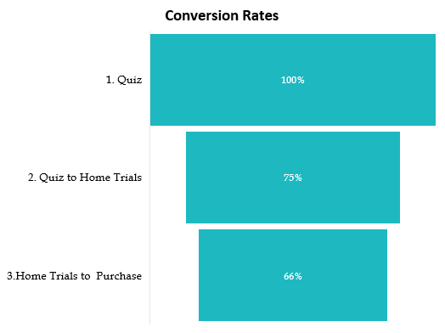
HOME-TRY-ON FUNNEL
Notes:
The total users graph shows we started the quiz with 1,00 users and only 495 ended up making a purchase.
That’s around 49% of the customers who took the quiz, made the purchase.
The conversion rates graph shows 75% of the users converted from quiz to home trials.
Only 66% users converted from home trials to purchase.

Slide 12
HOME-TRY-ON FUNNEL
A/B Test:
50% of users were given 3 pairs to try on.
50% of users were given 5 pairs to try on.
Purchase rate increased when users were given 5 pairs to try.
Conclusion: number of pairs given to users can affect their decision to make a purchase.
AB_variant | Home Trial | Purchase | Purchase Converstion
3 pairs | 379 | 201 | 53%
5 pairs | 371 | 294 | 79%
Total | 750 | 495 | 66%
Notes:
The result of the A/B test shows more pairs were sold from the 5 pairs test.
When given 3 pairs, 53% of the users made a purchase.
When given 5 pairs, 79% of the users made a purchase.
Users who get more pairs to try on at home will more likely to make a purchase.
Note that A/B testing does not account for the added cost of shipping multiple eyeglasses. We should account that into the analysis to determine if its still profitable for the company to increase the number of pairs for home trials.
For our purpose, we will not dive deeper into that analysis. Also, we were not provided data to perform that analysis.

Slide 13
OTHER INSIGHTS
Common Style & Model

Slide 14
OTHER INSIGHTS
Common Style - Survey
Common Style - Purchased
Style | Type Selected | Common Style in Survey
Women's Styles | 469 | 47%
Men's Styles | 432 | 43%
I'm not sure. Let's skip it. | 99 | 10%
TOTAL | 1,000 | 100%
Style | Type Selected | Common Style Purchased
Women's Styles | 252 | 51%
Men's Styles | 243 | 49%
TOTAL | 495 | 100%
Notes:
As shown on the charts, women’s styles are slightly more common for both the survey and actual purchase.
Note that during the survey, users also have the open to select the ‘Skip it” option.

Slide 15
OTHER INSIGHTS
Most popular model sold was Eugene Narrow
Most expensive glasses sold was $150
The cheapest glasses sold was $50
Model Name | Qty Sold
Eugene Narrow | 116
Dawes | 107
Brady | 95
MAX(price) | MIN(price)
$150 | $50

Slide 16
RESOURCES
SQL project from www.Codecademy.com
Warby Parker at www.warbyparker.com
SQL file & detail analytics at https://github.com/Ankush-Kumar421

